Slide 1



ATR
Help & Hope

Slide 2
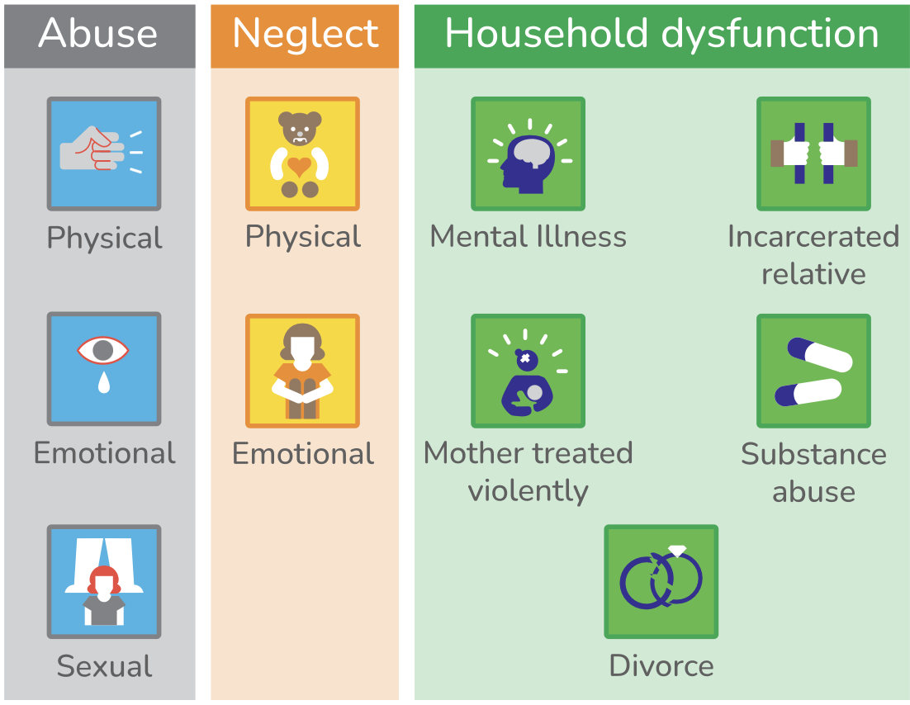
Bradford District ATR Help & Hope
Adverse childhood experiences are stressful or traumatic events that happen in childhood and can affect people as adults. They include events that affect a child or young person directly such as abuse or neglect. adverse childhood experiences also include things that affect children indirectly through the environment they live in. This could be living with a parent or caregiver who has poor mental health, where there is domestic abuse, or where parents have divorced or separated. These can be single events, long-term or repeated experiences.
In circumstances where a child has been exposed to traumatic events in childhood early intervention can help to create resilience and protective factors. These protective factors can help to avoid damaging and negative life-long physical and mental health effects.
The following list of support organisations is not exhaustive but provides much needed help and advice.
There is Help. There is hope.

Slide 3






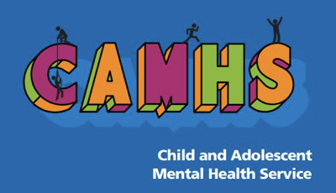

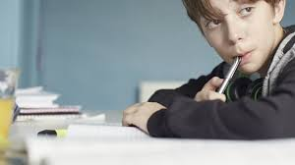


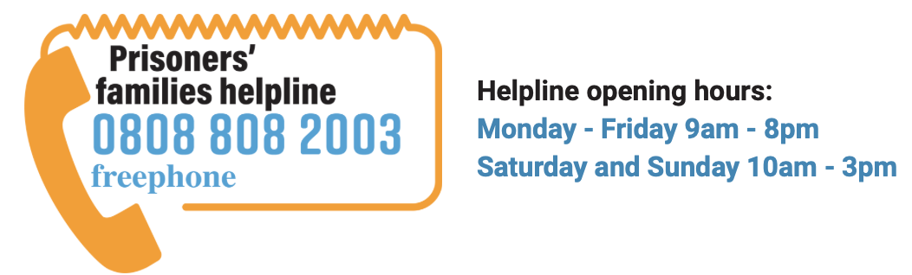
Bradford District ATR Help & Hope
Bradford District domestic abuse and sexual violence information BFDDASV
Family Action Children’s Trauma Therapy Service a specialist therapy service providing trauma and attachment focussed therapy for children and their families in Bradford District
Survive and Thrive for survivors of domestic and sexual abuse in the Bradford District.
Bradford Children and Families Trust protecting children from physical, emotional or sexual abuse or neglect.
Bradford District domestic abuse and sexual violence information
Family Action Children's Trauma Therapy Service
Survive and Thrive
Bradford Children and Families Trust
Bradford District NHS Child and Adolescent Mental Health service (CAMHS)
Mind Bradford District and Craven kids time workshops for families where a parent or carer has been diagnosed with a mental illness.
The Brathay Trust NSPCC Learning Domestic Abuse Learning Together ( DART)
Healthy Minds : Find mental health information, advice and support
Childline Parents in Prison We're here for you, whatever's on your mind.
Bradford NHS CAMHS
Mind Bradford and Craven kidstime
Brathay Trust NSPCC Domestic Abuse Recovering Together
Healthy Minds mental health support services
Childline Parents in Prison
New Vision Bradford will support you to help achieve and sustain recovery from alcohol and drug misuse through a range of treatments.
Families and Young Persons Information help to work through conflict and help you talk positively to your children about what is happening.
Prisoners Families Helpline free, confidential support and advice for families in England and Wales
New Vision Bradford Alcohol and Drug support
Prisoners Families Helpline
Families and Young Persons information Divorce and separation

